Slide 1
“I am learning the professions” educational scenario
Dr Panou Olga

Slide 2
Scenario title & Short description
Title: I am learning the professions
Description: The teaching scenario is a proposal, which concerns the way in which the teaching of the 5th teaching unit of the Modern Greek Language of the 2nd Grade of Junior High School on the topic "Work-Profession" will be organized

Slide 3
Educational audience & context
Level of education to which the Teaching Practice refers: Secondary
Class to which it will be applied: 2nd Grade of Junior High School
Type of Teaching Practice: Sequence of Longer Course Plans (Teaching Scenario) and TBL
Number of students: 12 refugees
Age of children: 14-15
Estimated duration: 6 hours (3 teaching hours)

Slide 4
Authors’ design rationale
General Purpose: to develop their research and critical thinking skills as well as the skills of oral presentation of a topic using the new vocabulary, related to work and profession
Utilization of ICT: the internet is used for research, as well as digitized teaching materials (photos, videos, pictures, etc.)
Teaching Practice: Enriched teaching, brainstorming, education through Art, teamwork, simulation, questions-answers, free discussion with arguments

Slide 5
Sub-objectives
Sub-Objectives in terms of the subject matter and in terms of the learning process:
  Knowledge
    Learn about the state of certain occupations in the job market today and understand that jobs and occupations change based on the skills required and useful (developing critical thinking)
    To know and assimilate an expanded thematic vocabulary
  Skills
    To learn to collect material from different sources and in different ways of research and to organize it so that it is presented as a simple task ("I learn how to learn")
    Be able to understand and discuss different types of text in relation to work and profession
    To practice in the production of mainly oral speech, addressing mainly to a receiver that is familiar to them
  Attitudes
    To reconsider their attitude towards professions that do not have much prestige in modern western societies (social ability, cultural consciousness)
    Develop a positive attitude towards the messages they receive from a work of art and see it as a source of knowledge
    Collaborate to produce a common (research) result

Slide 6
Learning Objectives
LEARNING OBJECTIVES | BLOOM TAXONOMY LEVEL | LANGUAGE LEARNING COMPETENCIES | ACTIVITY
Knowledge
• Learn about the state of certain occupations in the job market today and understand that jobs and occupations change based on the skills required and useful | 2nd level: I understand 4th level: I analyze 5th level: I evaluate | speaking, listening, reading, and writing | 1st meeting, Phase A 1st meeting, phase B 2nd meeting, Phase A
• To know and assimilate an expanded thematic vocabulary | 1st level: I remember 2nd level: I understand | speaking, listening, reading, and writing | 1st meeting, Phase A 1st meeting, Phase B 2nd meeting, Phase A
Skills
• Learn to collect material from different sources and in different ways of research and organize it so that it is presented as a simple task | 2nd level: I understand 3rd level: I apply | speaking, listening, reading, and writing | 2nd meeting, phase B
• Be able to understand and discuss different types of text in relation to work and profession | 2nd level: I understand 4th level: analyze | speaking, listening, reading, and writing | 1st meeting, phase B
• To practice in the production of mainly oral speech, addressing mainly to a receiver that is familiar to them | 1st level: I remember 3rd level: I apply | speaking, listening, reading, and writing | 2nd meeting, Phase A 3rd meeting, Phase A 3rd meeting, Phase C
Attitudes
• To reconsider their attitude towards professions that do not have much prestige in modern western societies | 4th level: I analyze 5th level: I evaluate | speaking, listening, reading, and writing | 2nd meeting, Phase B
• Develop a positive attitude towards the messages they receive from a work of art and see it as a source of knowledge | 3rd level: I apply 4th level: I analyze 5th level: I evaluate | speaking, listening, reading, and writing | 3rd meeting, Phase A.
• Collaborate to produce a common result | 3rd level: I apply 5th level: I evaluate | speaking, listening, reading, and writing | 2nd meeting, Phase B

Slide 7
1st Teaching meeting (two hours)
1. Goal: to learn about the world of work and professions
2. Rationale: The pedagogical value of this activity lies in text comprehension and encoding, as well as the use of team play that make learning fun
Phase A: Starting point
A series of photos is presented to the projector and the teacher addresses a series of questions to the whole class, in order to a) understand what knowledge and experiences the students already have about the professions and the workplace and b) to introduce some of the new words, which they will encounter in the texts later. They write them in a table in Word application, as they hear them, in categories
Phase B: study of texts and completion of a vocabulary table
There is a brief guided discussion on occupations, qualifications and working conditions
As Homework is given the link with the list of thematic vocabulary that has been created / completed on Padlet (https://padlet.com/user327/uuachnqktr2216cf), in order to study, and we announce that there will be a vocabulary competition in the next meeting.

Slide 8
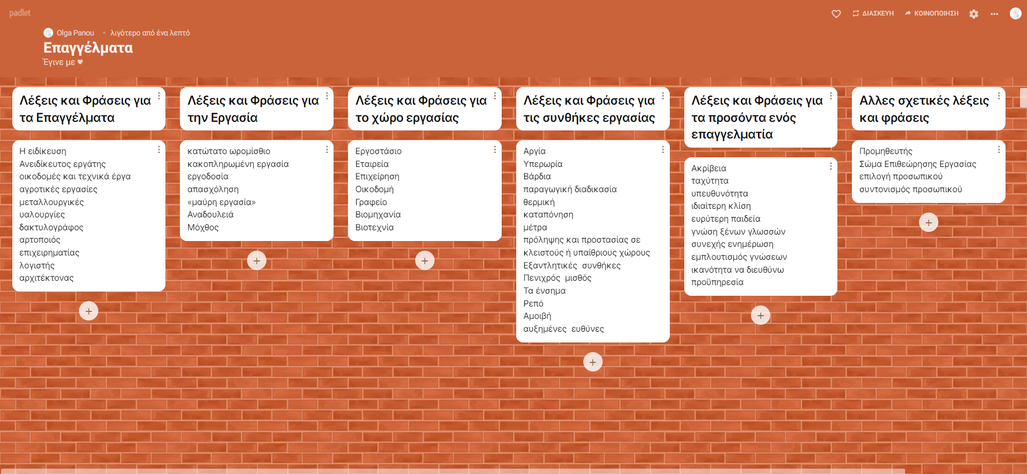
Phase B

Slide 9
2nd Teaching meeting (two hours)
1. Goal: learn new words, to work as a team and do research
2. Rationale: The three activities of phase A have a pedagogical meaning but also, while the first two are activities of understanding the new vocabulary, they aim at its use-production of oral speech with simple phrases, through the third activity, Taboo
Phase A: thematic vocabulary competition
  1. DOMINO Award
  2. Words in Categories Award
  3. Taboo Award
Phase B: Instructions for Research work in small groups
Students in small groups research the profession they have decided to present. They create a small poster in Canva (https://www.canva.com/create/posters/) to present the profession they have chosen. They cut out photos from magazines and decorate their poster. They also put a title.

Slide 10
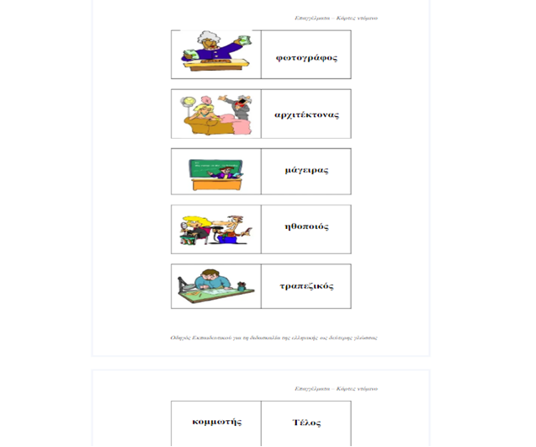
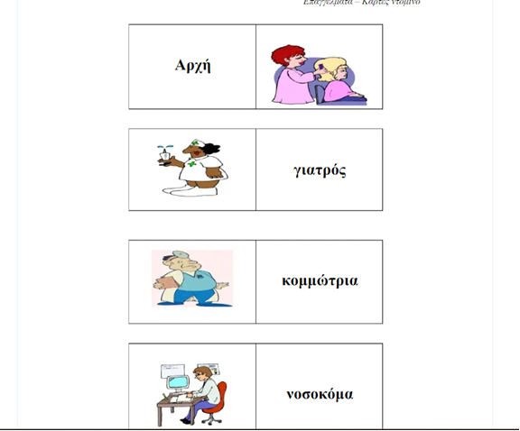
Domino Award

Slide 11
3rd teaching meeting (two hours)
1. Goal: learn to have a dialogue and review their attitudes, after assimilating new information
2. Rationale: The pedagogical value of this activity lies in learning who to make a research, as well as the use of team play that make learning fun
Phase A: A Classroom Profession Festival is created
Phase B: Discussion about the results of this work, about the cooperation and the climate in the groups

Slide 12

Classroom Profession Festival
Each group hangs a small poster on the classroom walls to present the profession
One of each group stands in front of the poster to give information to the Festival's visitors about this profession - consulting the notes they kept from their research - while the other two go to the exhibition and ask about other professions (simulation)
From time to time roles change, so that all students can move around and be informed about the professions that interest them

Slide 13
Extension of activity (two extra hours)
Individual homework:
Students are encouraged to study the career guidance test found online at https://paroutsas.jmc.gr/iqtest/orient2.htm and, after completing it, to see the results
Group work:
Then students work in groups. Each team tries to guess what the test result was for each of its members. The team discusses the test results, its reliability, the theory on which it is based (described on the website), the ideas about which professions would suit each of its members. The group comes to conclusions which are discussed in class plenary.

Slide 14
Evaluation
During the application of the Teaching Practice, the teacher and the students carry out its evaluation, through a reflective process
At the end of the third two hours there is a discussion about the results of this work, the cooperation and the atmosphere in the groups, the way of working and collaborative learning
Students are asked to evaluate themselves whether their collaboration worked and how much this way of learning helps them

Slide 15
References
Churches, A. (2008). Bloom's Digital Taxonomy.
Zhang, F. (2012). Computer-enhanced and Mobile-Assisted Language Learning: Emerging Issues and Trends, Indexed by scopus.

